Slide 1

CSE 604 Artificial Intelligence
Chapter 3 (part 2): Heuristic Search
Dr. Ahmedul Kabir
Adapted from slides available in Russell & Norvig’s textbook webpage

Slide 2
Outline
Heuristics
Best-first search
Greedy best-first search
A* search
More on heuristics

Slide 3
Definition of heuristics
A heuristic technique (/hjuːˈrɪstɪk/; Ancient Greek: εὑρίσκω, "find" or "discover"), often called simply a heuristic, is any approach to problem solving, learning, or discovery that employs a practical method not guaranteed to be optimal or perfect, but sufficient for the immediate goals.
Heuristics can be mental shortcuts that ease the cognitive load of making a decision.
Examples of this method include using a rule of thumb, an educated guess, or common sense.
https://en.wikipedia.org/wiki/Heuristic

Slide 4
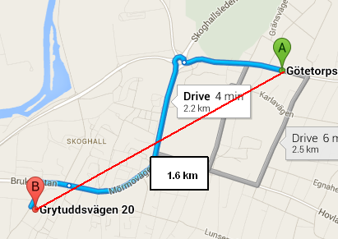
Example: Driving from A to B
The straight line distance is a heuristic to estimate the driving distance

Slide 5
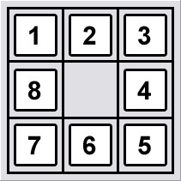
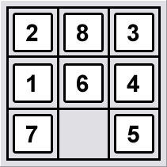
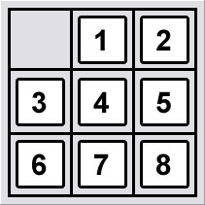
Example: 8-puzzle problem
Which state is “closer” to the goal state?
How can we quantify this?

Slide 6
Best-first search
Idea: use an evaluation function f(n) for each node
estimate of "desirability“
Expand most desirable unexpanded node
Implementation:
Order the nodes in fringe in decreasing order of desirability
Special cases:
Greedy best-first search
A* search

Slide 7
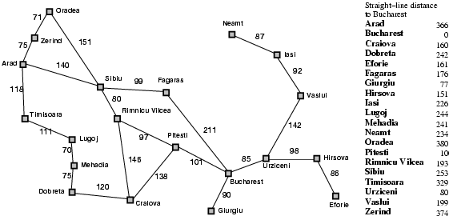
Romania with step costs in km

Slide 8
Greedy best-first search
Evaluation function f(n) = h(n) (heuristic)
= estimate of cost from n to goal
e.g., h_{SLD}(n) = straight-line distance from n to Bucharest
Greedy best-first search expands the node that appears to be closest to goal

Slide 9

Greedy best-first search example

Slide 10
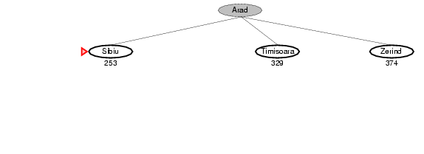
Greedy best-first search example

Slide 11
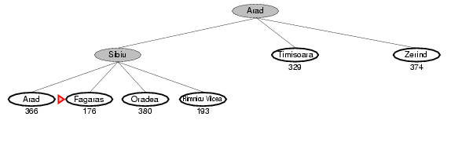
Greedy best-first search example

Slide 12
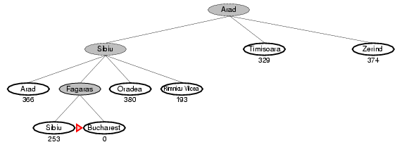
Greedy best-first search example

Slide 13
Properties of greedy best-first search
Complete? No – can get stuck in loops, e.g., when going from Iasi to Fagars:
Iasi → Neamt → Iasi → Neamt →
Time? O(b^{m}), but a good heuristic can give dramatic improvement
Space? O(b^{m}) -- keeps all nodes in memory
Optimal? No

Slide 14
A* search
Idea: avoid expanding paths that are already expensive
Evaluation function f(n) = g(n) + h(n)
g(n) = cost so far to reach n
h(n) = estimated cost from n to goal
f(n) = estimated total cost of path through n to goal

Slide 15

A* search example

Slide 16
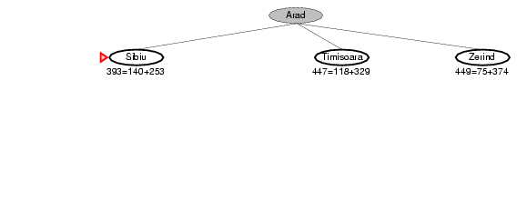
A* search example

Slide 17
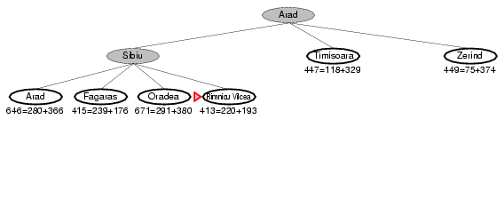
A* search example

Slide 18
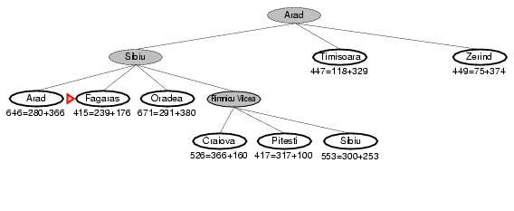
A* search example

Slide 19
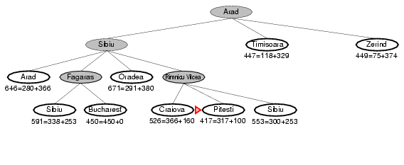
A* search example

Slide 20
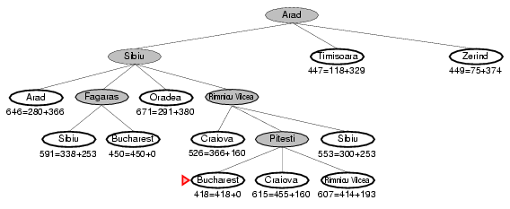
A* search example

Slide 21
Admissible heuristics
A heuristic h(n) is admissible if for every node n,
h(n) ≤ h*(n), where h*(n) is the true cost to reach the goal state from n.
An admissible heuristic never overestimates the cost to reach the goal, i.e., it is optimistic
Example: h_{SLD}(n) (never overestimates the actual road distance)
Theorem: If h(n) is admissible, A* using TREE-SEARCH is optimal

Slide 22
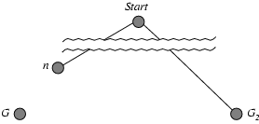
Optimality of A* (proof)
Suppose some suboptimal goal G₂ has been generated and is in the fringe. Let n be an unexpanded node in the fringe such that n is on a shortest path to an optimal goal G.
We need to show: f(n) < f(G₂)
f(n) = g(n) + h(n)
≤ g(n) + c(n, G) since h is admissible
= g(G)
< g(G₂) since G₂ is suboptimal
= f(G₂) since h(G₂) = 0
Hence f(G₂) > f(n), and A* will never select G₂ for expansion

Slide 23
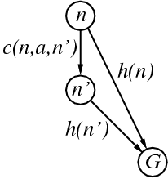
Consistent heuristics
A heuristic is consistent if for every node n, every successor n' of n generated by any action a,
h(n) ≤ c(n,a,n') + h(n')
If h is consistent, we have
f(n') = g(n') + h(n')
= g(n) + c(n,a,n') + h(n')
≥ g(n) + h(n)
= f(n)
i.e., f(n) is non-decreasing along any path.
Theorem: If h(n) is consistent, A* using GRAPH-SEARCH is optimal

Slide 24
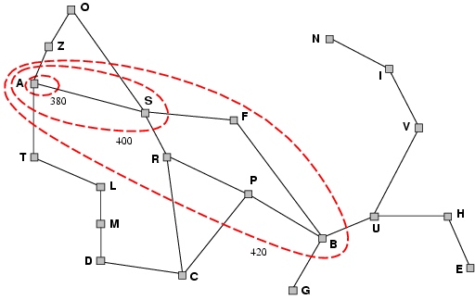
Optimality of A*
A* expands nodes in order of increasing f value
Gradually adds "f-contours" of nodes
Contour i has all nodes with f=f_{i}, where f_{i} < f_{i+1}

Slide 25
Properties of A*
Complete? Yes (unless there are infinitely many nodes with f ≤ f(G) )
Time? Exponential
Space? Keeps all nodes in memory
Optimal? Yes

Slide 26
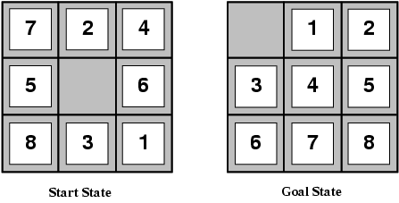
Admissible heuristics
E.g., for the 8-puzzle:
h₁(n) = number of misplaced tiles
h₂(n) = total Manhattan distance
(i.e., no. of squares from desired location of each tile)
h₁(S) = ?
h₂(S) = ?

Slide 27
Admissible heuristics
E.g., for the 8-puzzle:
h₁(n) = number of misplaced tiles
h₂(n) = total Manhattan distance
(i.e., no. of squares from desired location of each tile)
h₁(S) = ? 8
h₂(S) = ? 3+1+2+2+2+3+3+2 = 18

Slide 28
Dominance
If h₂(n) ≥ h₁(n) for all n (both admissible)
then h₂ dominates h₁
h₂ is better for search
Typical search costs (average number of nodes expanded):
d=12 IDS = 3,644,035 nodes A*(h₁) = 227 nodes A*(h₂) = 73 nodes
d=24 IDS = too many nodes A*(h₁) = 39,135 nodes A*(h₂) = 1,641 nodes
Why is A* so much better?
Because it reduces the effective branching factor

Slide 29
Relaxed problems
A problem with fewer restrictions on the actions is called a relaxed problem
The cost of an optimal solution to a relaxed problem is an admissible heuristic for the original problem
If the rules of the 8-puzzle are relaxed so that a tile can move anywhere, then h₁(n) gives the shortest solution
If the rules are relaxed so that a tile can move to any adjacent square, then h₂(n) gives the shortest solution

